Slide 1

Global Electric Vehicle Adoption Trends (2010–2024)
Presented By:
VEDASRI BHONAGIRI
Batch no: 456

Slide 2
Agenda
Introduction / Global EV Market Overview.
Business Problem.
Types of vehicles.
Global EV Trends.
Regional and Category Trends.
Powertrain and Mode Analysis.
Parameter and Unit Analysis.
Conclusion.
Recommendations.

Slide 3
Introduction
Rising energy demand and climate concerns are driving a global shift toward electric mobility, as transportation remains a major source of emissions.
Environmental regulations and increasing fuel costs are accelerating EV adoption, though growth varies by region, vehicle category, and powertrain.
Data analytics is essential to understand EV growth patterns and support effective infrastructure planning and policy decisions.
Transportation contributes nearly 25% of global CO₂ emissions, making EV adoption critical.

Slide 4
Business Problem
How has global EV adoption evolved from 2010–2024 across regions, vehicle categories, and powertrain technologies, and what factors drive these changes?

Slide 5
TYPES OF VEHICLES
BEV (Battery Electric Vehicle): Operates solely on electric power stored in batteries, with no use of petrol or diesel engines.
PHEV (Plug-in Hybrid Electric Vehicle): Combines an electric motor and a fuel engine, and can be recharged by plugging into an external power source.
HEV (Hybrid Electric Vehicle): Uses a conventional fuel engine supported by an electric motor, without the need for external charging.
FCEV (Fuel Cell Electric Vehicle): Generates electricity using hydrogen fuel cells, producing water as the only by-product.

Slide 6
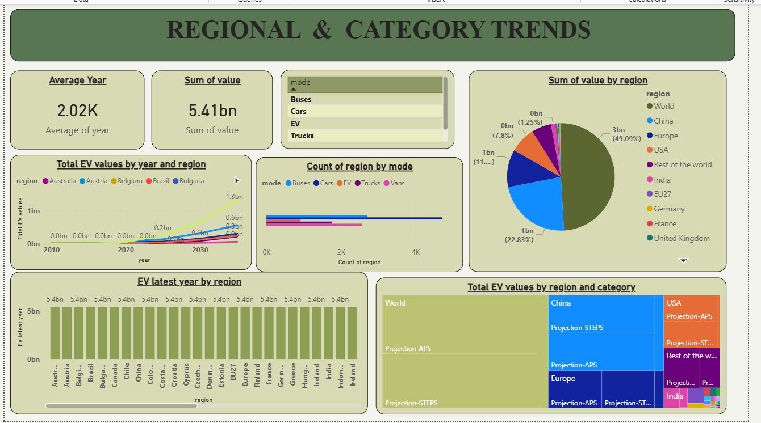

Slide 7
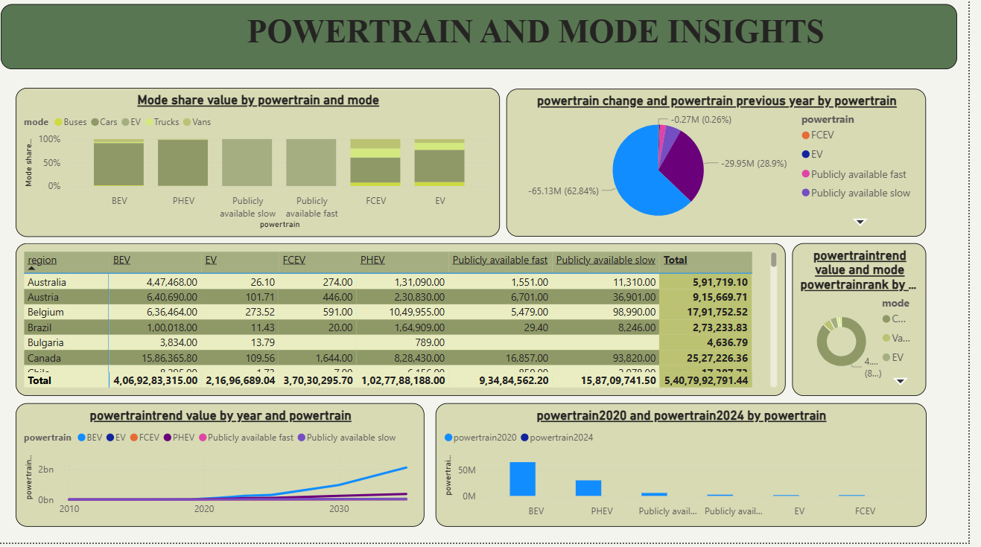

Slide 8
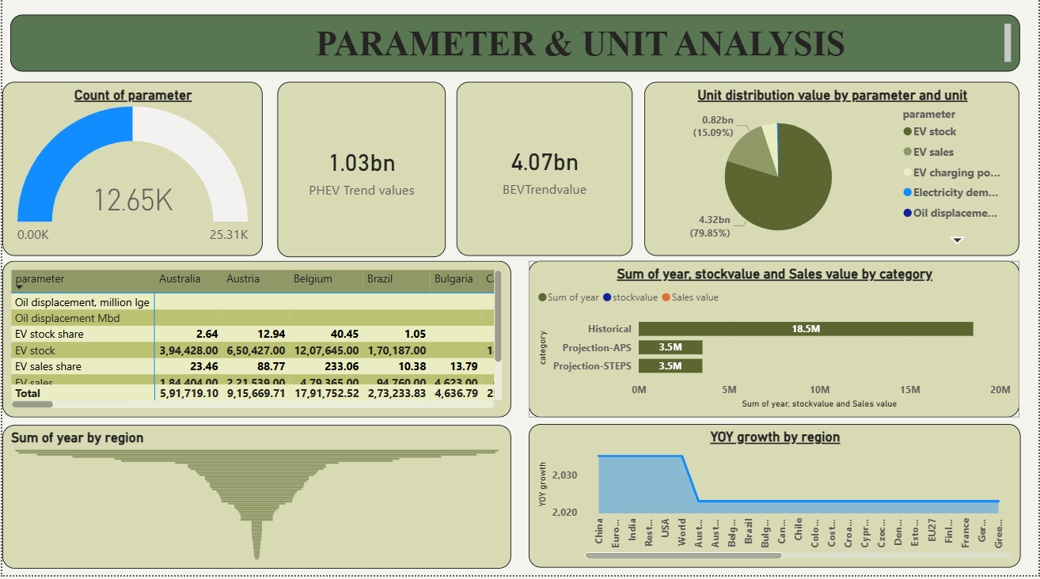

Slide 9
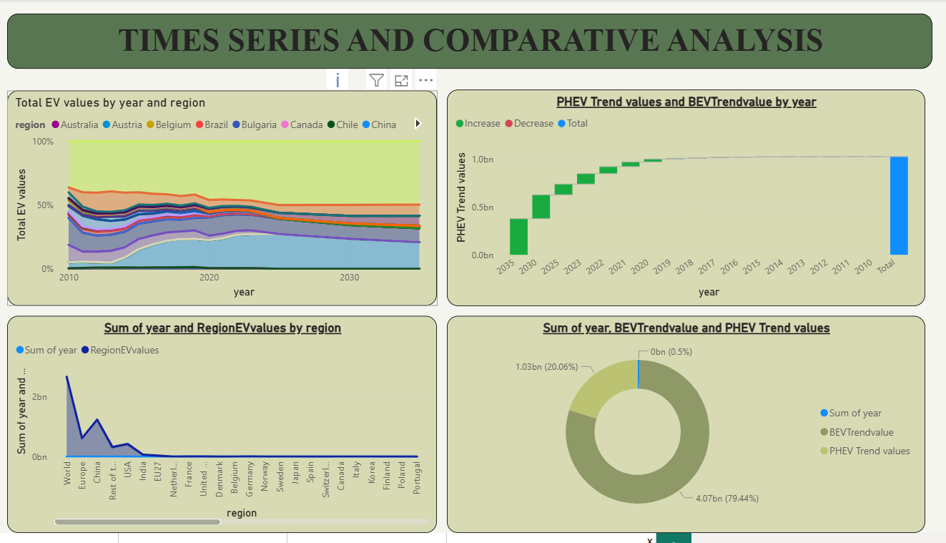

Slide 10
What the Data Reveals
EV adoption is accelerating globally.
BEVs dominate most regions.
Policy-driven regions grow faster.
Infrastructure readiness is a key driver.

Slide 11
Conclusion
The global EV market is transitioning rapidly due to policy support, technological advancements, and environmental necessity. Data analytics plays a vital role in guiding sustainable mobility decisions.

Slide 12
Recommendations
Expand charging infrastructure in emerging markets.
Promote affordable EV models.
Strengthen regional EV policies.
Encourage clean energy integration.

Slide 13

THANK YOU

